Slide 1
Lecture 8
SQL Language - DML, DCL, TCL

Slide 2
SQL DML
Commands SELECT, INSERT, UPDATE, DELETE, MERGE
Transaction processing
Depends on the client settings(autocommit on|off)
Let’s suppose autocommit off, then:
transaction is done by sequence of DML and SELECT commands
confirmed by COMMIT
canceled by ROLLBACK
during the transaction the other sessions uses old values, till that is not confirmed
commands DDL or DCL make COMMIT implicitly
The systematic description of Transaction processing will be presented later
During the DML commands processing the DBMS make check of integrity constraints.

Slide 3
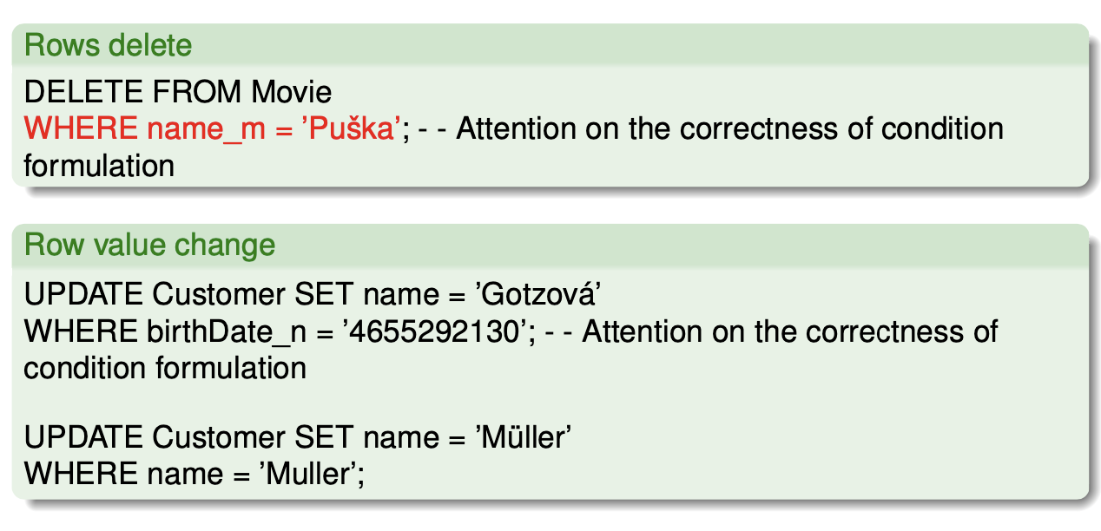
SQL actualization - examples

Slide 4
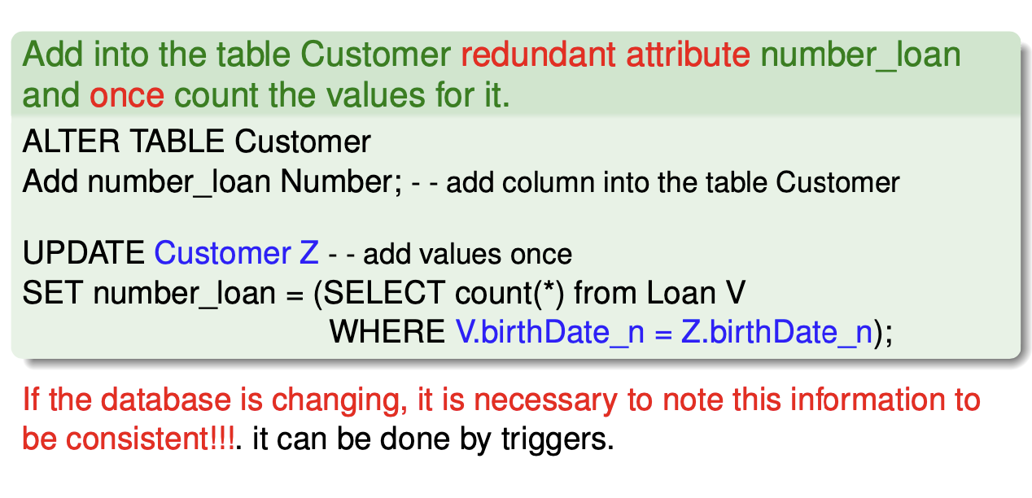
UPDATE more rows with subquery

Slide 5
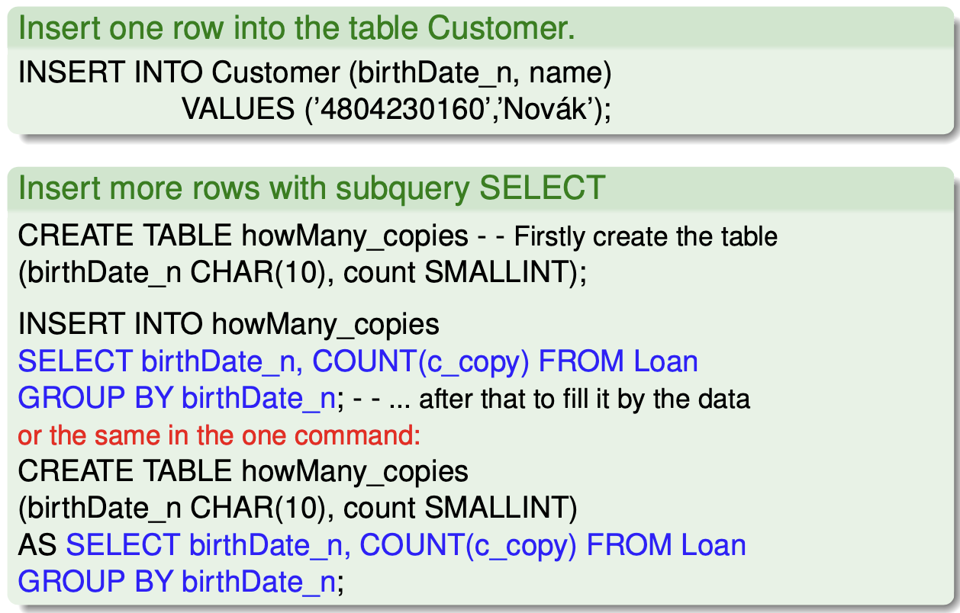
INSERT

Slide 6
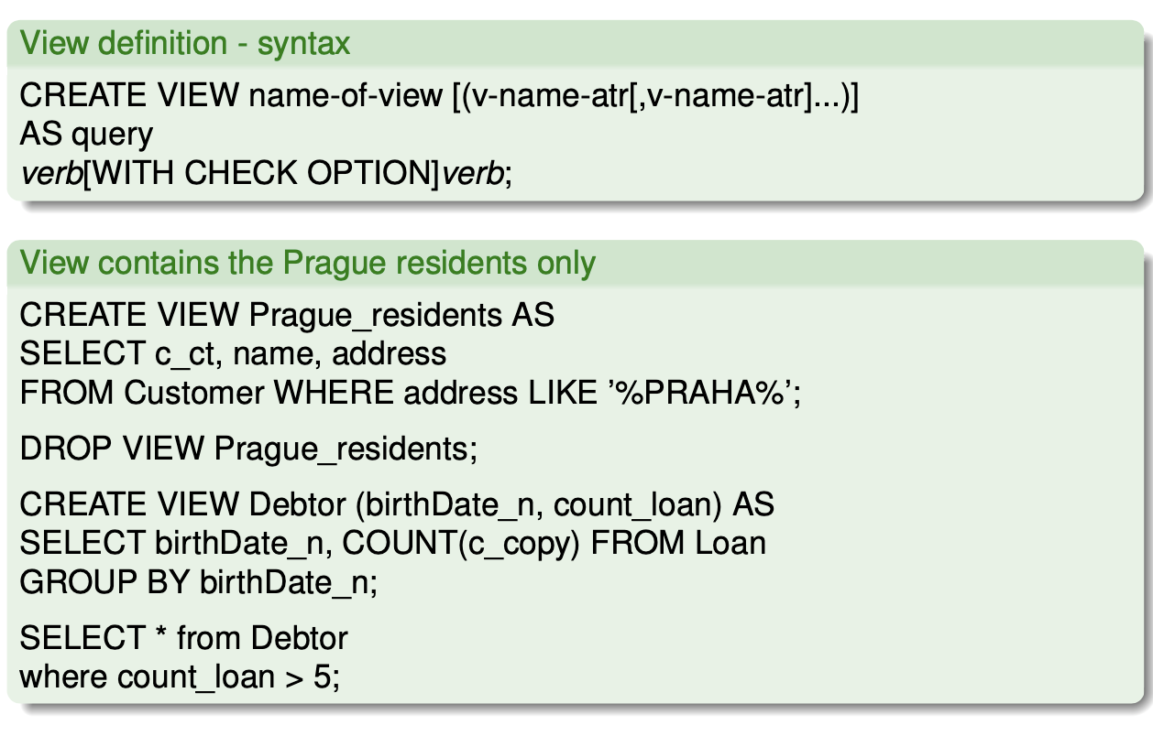
View - syntax, example

Slide 7
View - characteristic
View is virtual relation
at the table dictionary is stored as SELECT (what defines it)
from the point of view of queries is the table identical
DML partial operations above the views:
must be used “simple view” (don’t use join, aggregation, expressions, ...)
DML cannot be forbidden at the definition – clause READ ONLY I it’s recommended to use clause WITH CHECK OPTION
DML above “complex views” can be realized with instead-of triggers
why use views:
to hide information which should be hidden for particular user role I to help complicated queries to be easier
To allow application development easier
views doesn’t brings higher performance – for that can be used materialized views (MATERIALIZED VIEWS)

Slide 8
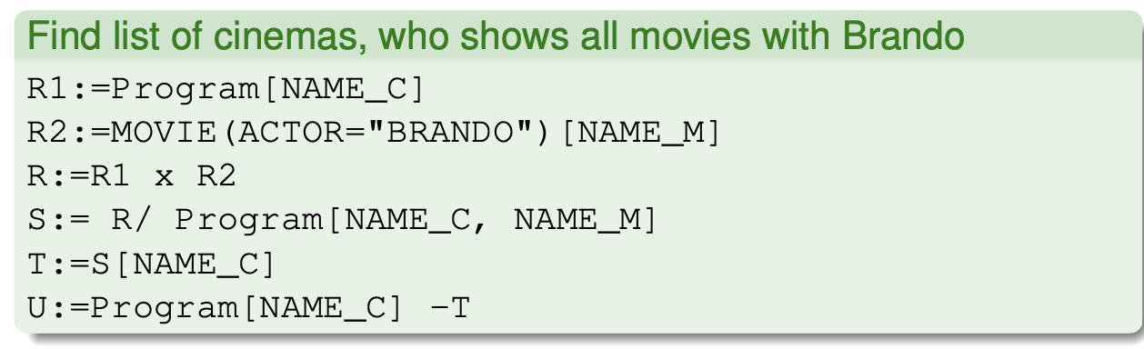
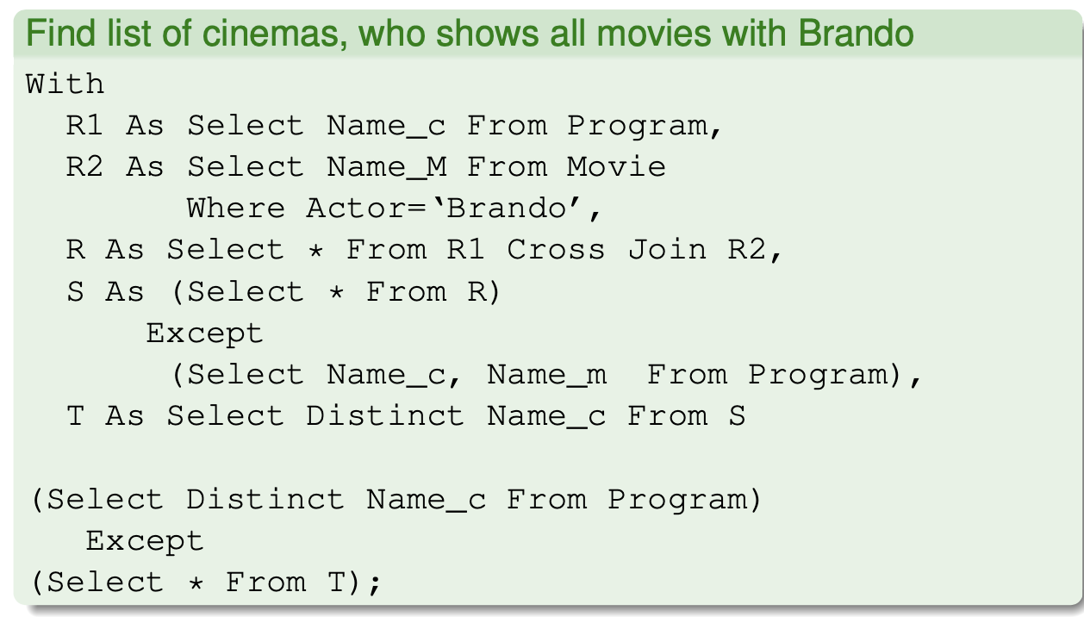
Command WITH - example

Slide 9
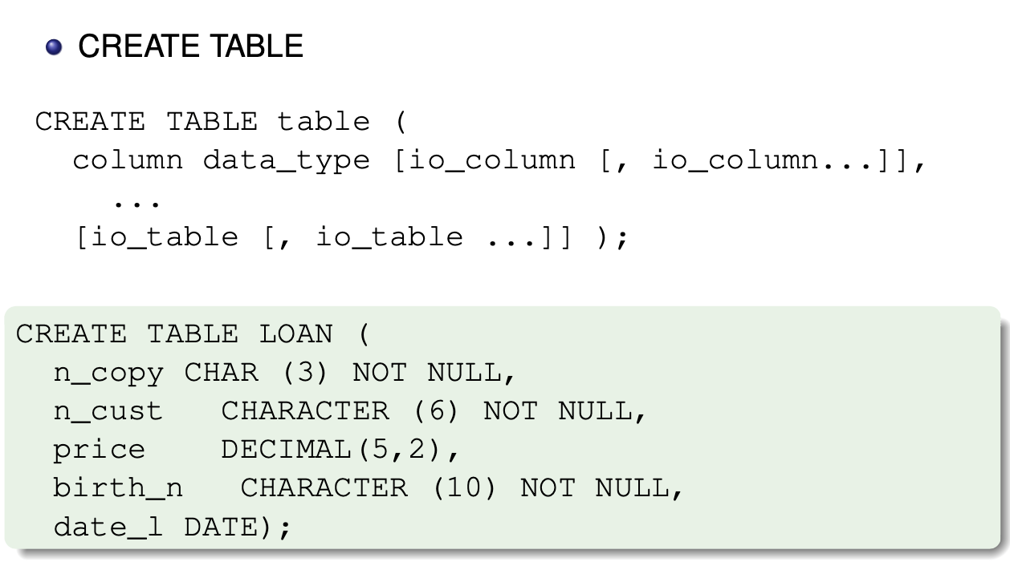
CREATE TABLE

Slide 10
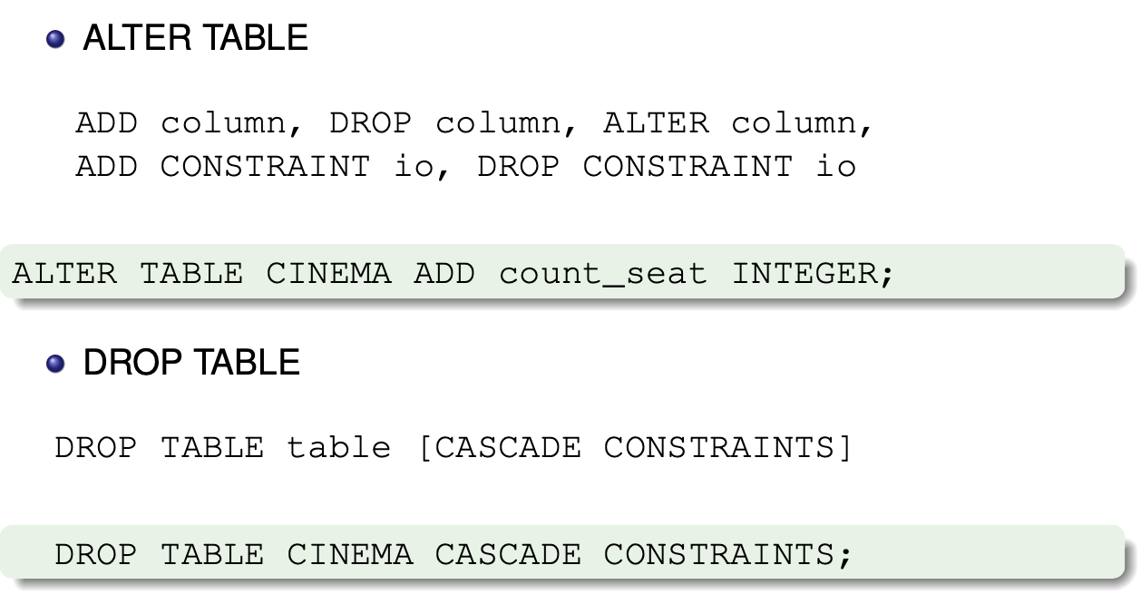
ALTER TABLE, DROP TABLE

Slide 11
Integrity constraints in SQL
IC columns:
NOT NULL
DEFAULT
UNIQUE
PRIMARY KEY
REFERENCES
CHECK
IC table - identical as IC column
(NOT NULL special expression of CHECK) compound IC are every time at the table tier
name IC
is not syntactically necessary, but recommended

Slide 12
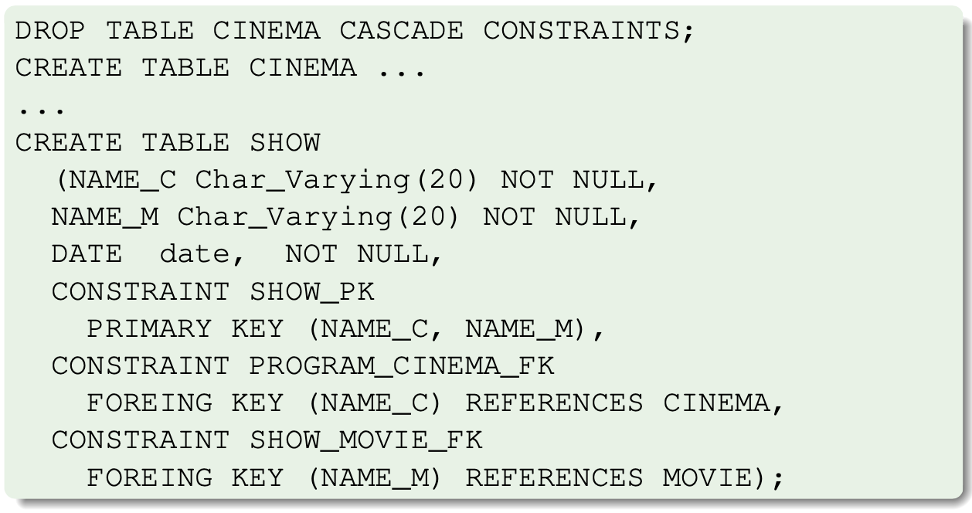
Example DDL with IC

Slide 13
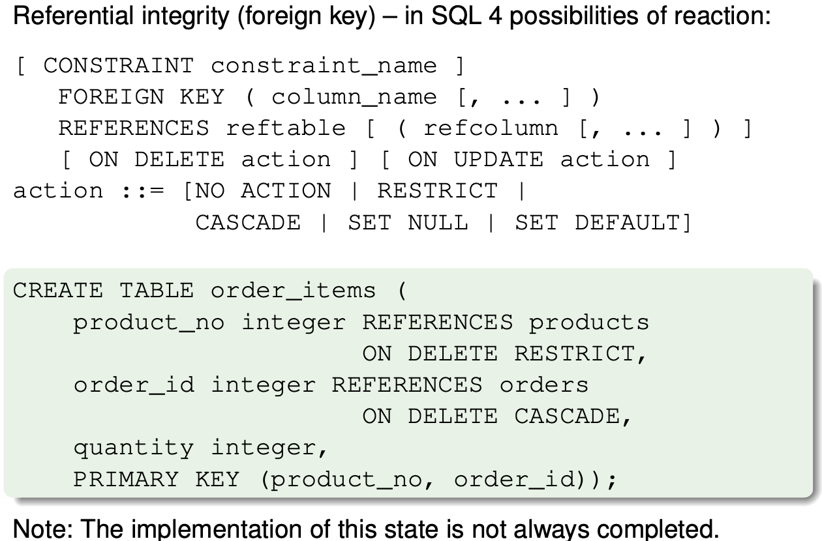
Referential integrity and cascade DELETE / UPDATE

Slide 14
Time of check IC, temporarily turn on/off IC
SQL defines possibilities to declare the time during it can be integrity constraint check active.
The IC check can be defined as (DEFERRED) into end of the transaction.
In the session frame is possible to set if IC is IMMEDIATE (in the session of DML execution) or after the transaction finished.
The operation allows in the command ALTER TABLE IC temporarily turn off - DISABLE/ENABLE CONSTRAINT.
The backward IC turn on can be/might not be required for integrity check of inserted data.

Slide 15
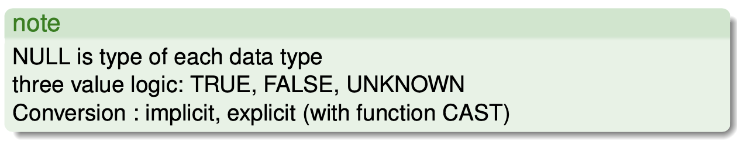
Data types in SQL
numeric
string
big string (CLOB)
big bitwise strings (BLOB)
date and time
interval

Slide 16
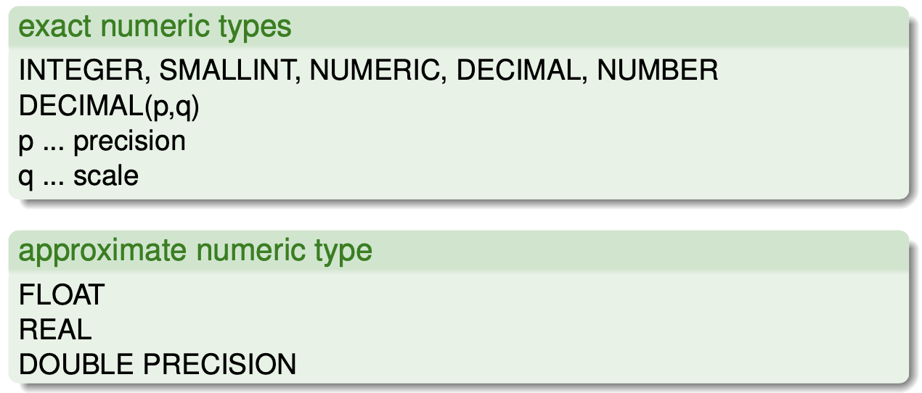
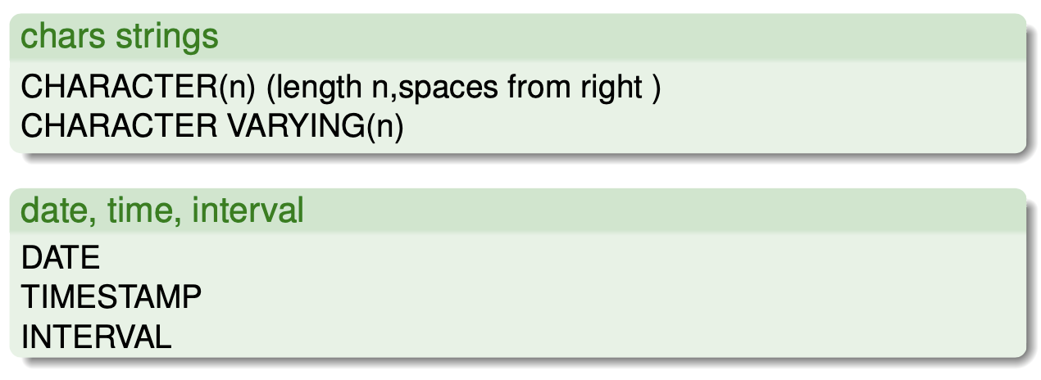
Data types in SQL

Slide 17
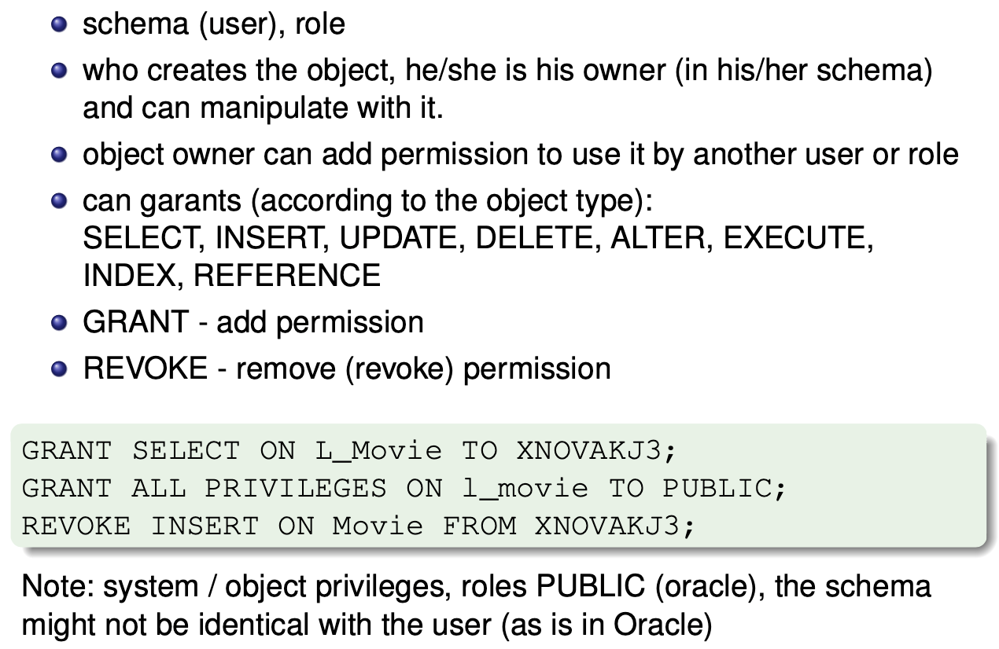
DCL - commands GRANT a REVOKE

Slide 18
Commands COMMIT, ROLLBACK, SAVEPOINT
Confirmation/cancellation changes done by particular transaction does not depend on number of DML and SELECT neither row numbers.
COMMIT - changes confirmation - all changes are persistently stored in the database, other sessions can see the changes from this moment.
ROLLBACK - changes cancellation - all changes are revoked in this transaction.
SAVEPOINT - use for custom definition “stemps” inside the transaction, which can be used for ROLLBACK.

Slide 19
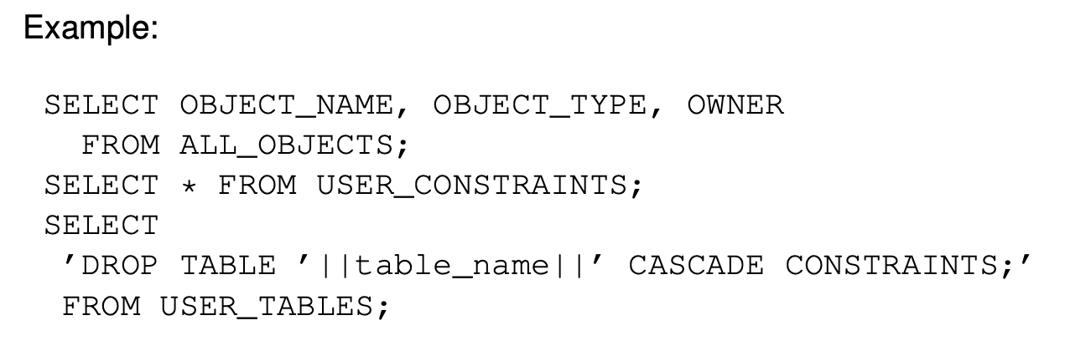
System catalog
System catalog, data dictionary, metadata:
database metadata approach
There exist standards but that are usualy violated by DB developer's
system catalog can be read by SELECT
above the system catalog allows “scripting” DB examples Oracle:
views with prefix USER_ , ALL_, DBA_

